Slide 1
Presentation
JAVA OPERATORS
CONTROL STAMENTS
P. Sai Kiran

Slide 2
JAVA OPERATORS

Slide 3
OPERATORS IN JAVA
Arithmetic Operators
Relational Operators
Logical Operators
Assignment Operators
Bitwise Operators
Conditional (Ternary) Operators

Slide 4
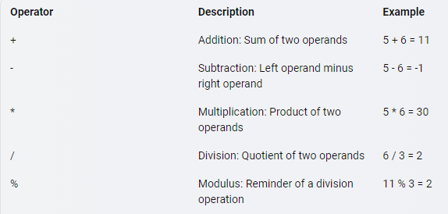
Arithmetic Operators
Arithmetic operators are used to perform mathematical operations on numeric operands. The following table lists all the arithmetic operators in Java:

Slide 5
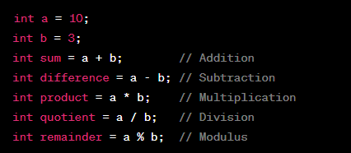
Example

Slide 6
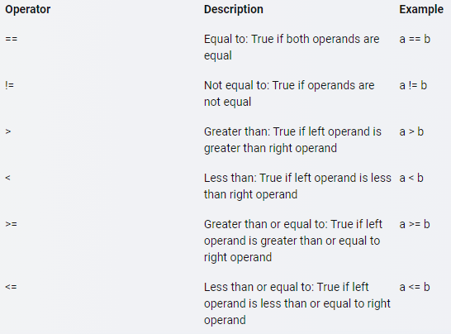
Relational Operators
Relational operators are used to compare two values and return a boolean value (true or false). The following table lists all the relational operators in Java:

Slide 7
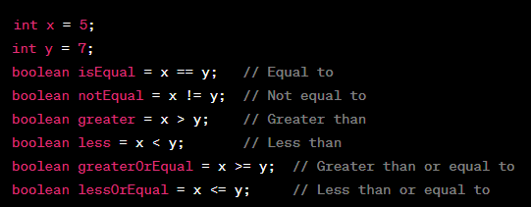
Example snippet

Slide 8
Logical Operators
Logical operators are used to combine multiple conditions and return a boolean value (true or false). The following table lists all the logical operators in Java:
Operator | Description | Example
&& | Logical AND: True if both operands are true, else false. | x > y && x < z
|| | Logical OR:OR operator returns True if either of the operands is True, else False. | x > y || x < z
! | Logical NOT: True if operand is false, else false. | !(x > y && x < z)

Slide 9
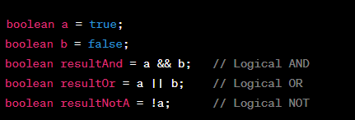
Example snippet

Slide 10
Assignment Operators
Assignment operators assign values to variables.
Common assignment operators include
Assignment (`=`)
Add and assign (`+=`)
Subtract and assign (`-=`)
Multiply and assign (`*=`)
Divide and assign (`/=`)
Modulus and assign (`%=`)

Slide 11
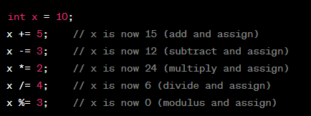
Example snippet

Slide 12
Bitwise Operators
Bitwise operators perform operations at the binary level.
Common bitwise operators include
Bitwise AND (`&`),
Bitwise OR (`|`),
Bitwise XOR (`^`),
Bitwise NOT (`~`),
Left shift (`<<`),
Right shift (`>>`),
Unsigned right shift (`>>>`).

Slide 13
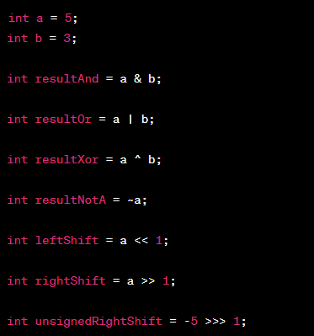
Example snippet

Slide 14
Conditional (Ternary) Operators
The ternary operator is a shorthand way of writing an if-else statement.
It has the form: condition ? expression1 : expression2,
where condition is evaluated, and if it's true, expression1 is returned; otherwise, expression2 is returned.

Slide 15

Example snippet

Slide 16
Control STATEMENTS

Slide 17
Conditional Statements:
If Statement
Else-If Statement
Switch Statement
Nested-If-else
Jump Statements:
Break Statement
Continue statement
Iterative Statements:
For Loop
For-Each Loop
While Loop
Do-While Loop

Slide 18
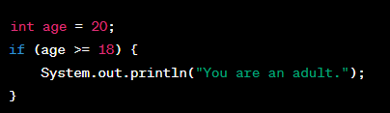
If Statement
The `if` statement is used for conditional execution.
It allows you to execute a block of code if a specified condition is true.
Example:

Slide 19
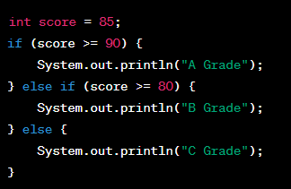
Else-If Statement
The `else if` statement allows you to check multiple conditions after the initial
`if` condition is false.
Example:

Slide 20
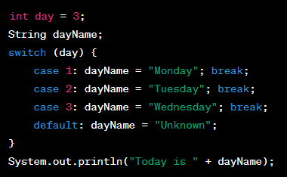
Switch Statement
The `switch ` statement is used for multi-way branching.
It allows you to select one of many code blocks to be executed.
`case` labels: Specify the code to execute if the expression matches.
Example:

Slide 21

For loop
The `for` loop is used for iterating over a range of values.
It typically consists of an initialization, a condition, and an increment/decrement expression.
Example:

Slide 22
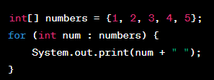
For-each loop
The enhanced `for-each` loop (also known as the "for-each" loop) is used to iterate through elements in an array or collection.
It simplifies the process of traversing an array or collection.
Example:

Slide 23
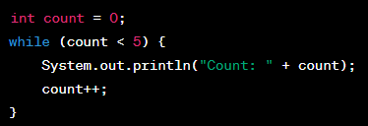
While Loop
The `while loop `is used to repeatedly execute a block of code as long as a specified condition is true.
Example:

Slide 24
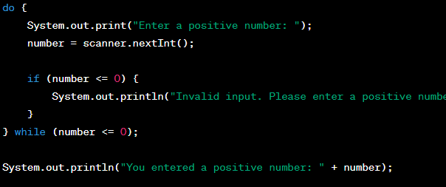
Do-while loop
The do-while loop is used for repeating a block of code as long as a specified condition is true. In a do-while loop, the code block is executed at least once before the condition is checked.

Slide 25
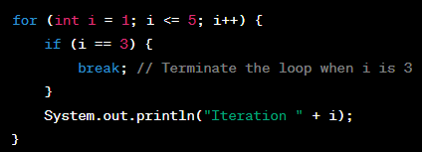
Break Statement
The `BREAK Statement` terminates the loop or switch statement and transfers control to the statement following the terminated statement.
Example:

Slide 26
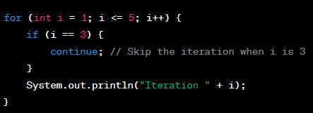
Continue statement
The `continue statement` jumps to the next iteration of a loop, skipping the remaining code in the current iteration.
Example:

Slide 27
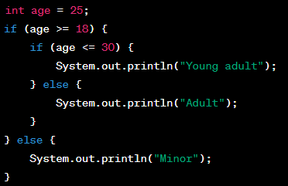
Nested-if-else
A nested if-else statement is an if-else statement inside another if or else block.
It's useful for handling more complex decision-making scenarios.

Slide 28
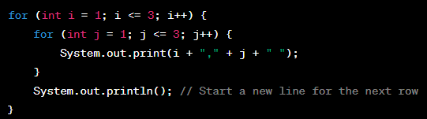
Nested-for-loop
A nested for loop is a loop inside another loop.
It's commonly used for tasks like matrix traversal.

Slide 29


